Slide 1
Machine Learning II
Lecture 5 – Back propagation – Part II
https://nextjournal.com/gkoehler/digit-recognition-with-keras

Slide 2

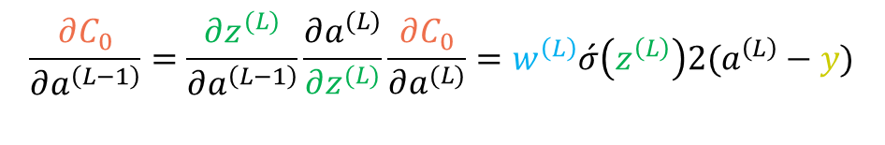

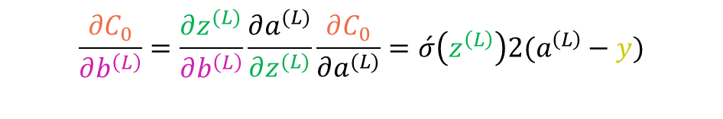


Back propagation- simple model
Let’s compute all the derivatives.
We need to average over all the training examples:
This is just one component of the whole derivative of cost function:
$$\frac{∂C_{0}}{∂w^{\left(L\right)}}=\frac{∂z^{(L)}}{∂w^{\left(L\right)}}\frac{∂a^{(L)}}{∂z^{(L)}}\frac{∂C_{0}}{∂a^{(L)}}$$
$$=a^{\left(L−1\right)}\acute{σ}\left(z^{\left(L\right)}\right)2(a^{\left(L\right)}−y)$$
$$\frac{∂C}{∂w^{\left(L\right)}}=\frac{1}{n}\sum_{k=0}^{n−1}{\frac{∂C_{k}}{∂w^{\left(L\right)}}}$$
$$∇C=\left[\begin{matrix}\begin{matrix}\begin{matrix}\frac{∂C}{∂w^{\left(1\right)}} \\ \frac{∂C}{∂b^{\left(1\right)}}\end{matrix} \\ ⋮\end{matrix} \\ \frac{∂C}{∂w^{\left(L\right)}} \\ \frac{∂C}{∂b^{\left(L\right)}}\end{matrix}\right]$$
$$\frac{∂C_{0}}{∂b^{\left(L\right)}}=\frac{∂z^{(L)}}{∂b^{\left(L\right)}}\frac{∂a^{(L)}}{∂z^{(L)}}\frac{∂C_{0}}{∂a^{(L)}}=\acute{σ}\left(z^{\left(L\right)}\right)2(a^{\left(L\right)}−y)$$
Now the question is, how sensitive the cost function is to the previous activation?
$$\frac{∂C_{0}}{∂a^{\left(L−1\right)}}=\frac{∂z^{(L)}}{∂a^{\left(L−1\right)}}\frac{∂a^{(L)}}{∂z^{(L)}}\frac{∂C_{0}}{∂a^{(L)}}=w^{\left(L\right)}\acute{σ}\left(z^{\left(L\right)}\right)2(a^{\left(L\right)}−y)$$
So we can use this methodology to find the sensitivity to all the neurons.

Slide 3

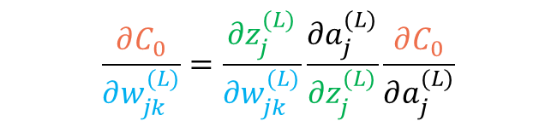










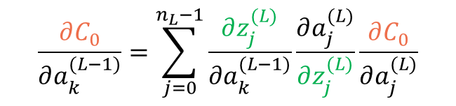


Back propagation
How about when we have more neurons? Pay attention to notations
Let’s look at one layer
Now Cost function of last layer will be:
Now to make a better view, let’s call the weight from neuron k to neuron j: $w_{jk}^{\left(L\right)}$
$$C_{0}=\sum_{j=0}^{n_{L}−1}{(a_{j}^{\left(L\right)}−y_{j})^{2} }$$
$$z_{j}^{(L)}=w_{j0}^{(L)}a_{0}^{(L−1)}+w_{j1}^{(L)}a_{1}^{(L−1)}+w_{j2}^{(L)}a_{2}^{(L−1)}+b_{j}^{(L)}$$
$$a_{j}^{(L)}=σ(z_{j}^{(L)})$$
$$a_{0}^{(L−1)}$$
$$0.10$$
$$a_{0}^{(L)}$$
$$0.81$$
$$\frac{∂C_{0}}{∂w_{jk}^{(L)}}=\frac{∂z_{j}^{(L)}}{∂w_{jk}^{(L)}}\frac{∂a_{j}^{(L)}}{∂z_{j}^{(L)}}\frac{∂C_{0}}{∂a_{j}^{(L)}}$$
$$a_{1}^{(L−1)}$$
$$0.40$$
$$0.40$$
$$a_{1}^{(L)}$$
$$\frac{∂C_{0}}{∂a_{k}^{(L−1)}}=\sum_{j=0}^{n_{L}−1}{\frac{∂z_{j}^{(L)}}{∂a_{k}^{(L−1)}}\frac{∂a_{j}^{(L)}}{∂z_{j}^{(L)}}\frac{∂C_{0}}{∂a_{j}^{(L)}}}$$
$$a_{2}^{(L−1)}$$
$$0.81$$
What is changed though?

Slide 4
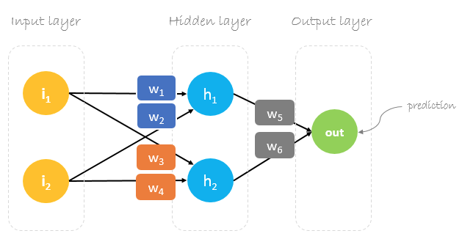
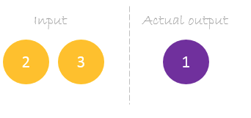




Numerical Example
Let’s start with initialization
$$x_{1}$$
$$a_{1}$$
$$x_{2}$$
$$a_{2}$$
w1 = 0.11, w2 = 0.21, w3 = 0.12, w4 = .08
w5 = 0.14 and w6 = 0.15
https://hmkcode.github.io/ai/backpropagation-step-by-step/

Slide 5
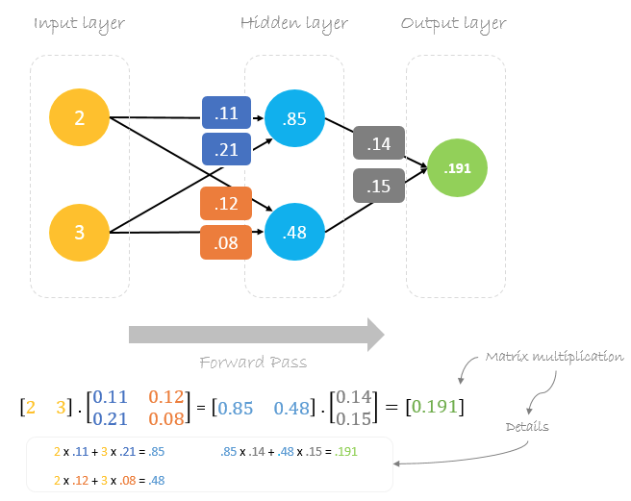
Numerical Example
https://hmkcode.github.io/ai/backpropagation-step-by-step/

Slide 6
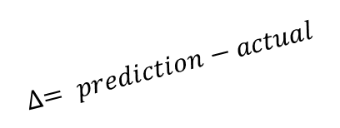






Numerical Example
$$x_{1}$$
$$a_{1}$$
Gradient descent.
$$W_{x_new}=W_{x}−γ(\frac{∂Cost}{∂W_{x}})$$
For $W_{6}$: $W_{6_new}=W_{6}−γ(\frac{∂Cost}{∂W_{6}})$
$$\frac{∂Cost}{∂W_{6}}=\frac{∂Cost}{∂prediction}.\frac{∂prediction}{∂W_{6}}$$
The predicted output is: $a_{1}W_{5}+a_{2}W_{6}$
$$\frac{∂Cost}{∂W_{6}}=\frac{∂\frac{1}{2}(prediction−actual)^{2}}{∂prediction}.\frac{∂{(a}_{1}W_{5}+a_{2}W_{6})}{∂W_{6}}$$
$$=2∗\frac{1}{2}\left(prediction−actual\right).a_{2}$$
$$W_{6_new}=W_{6}−γ∆a_{2}$$
$$W_{5_new}=W_{5}−γ∆a_{1}$$
$$x_{2}$$
$$a_{2}$$
$$∆= prediction−actual$$
$$Similarly:$$
https://hmkcode.github.io/ai/backpropagation-step-by-step/

Slide 7







Numerical Example
$$x_{1}$$
$$a_{1}$$
$$a_{1}={x_{1}W}_{1}+{x_{2}W}_{2}$$
$$x_{2}$$
$$a_{2}$$
Remember that
$\frac{∂Cost}{∂W_{1}}=\frac{∂Cost}{∂prediction}.\frac{∂prediction}{∂a_{1}}$. $\frac{∂a_{1}}{∂W_{1}}$
$=\frac{∂\frac{1}{2}(prediction−actual)^{2}}{∂prediction}.\frac{∂{{(a}_{1}W}_{5}+a_{2}W_{6})}{∂a_{1}}$. $\frac{∂({x_{1}W}_{1}+{x_{2}W}_{2})}{∂W_{1}}$
= $2∗\frac{1}{2}\left(prediction−actual\right).W_{5}.x_{1}$
= $∆W_{5}.x_{1}$
$$W_{1_new}=W_{1}−γ∆W_{5}.x_{1}$$
$W_{2_new}=W_{2}−γ∆W_{5}.x_{2}$
$W_{3_new}=W_{3}−γ∆W_{6}.x_{1}$
$W_{4_new}=W_{4}−γ∆W_{6}.x_{2}$
$$a_{2}={x_{1}W}_{3}+{x_{2}W}_{4}$$
https://hmkcode.github.io/ai/backpropagation-step-by-step/

Slide 8
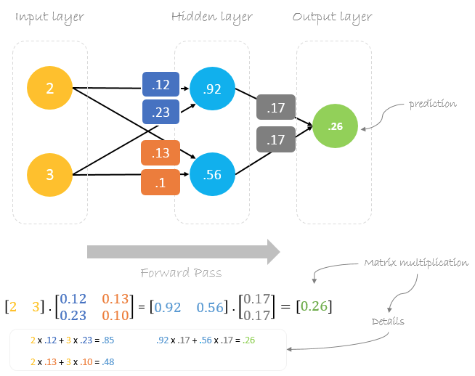
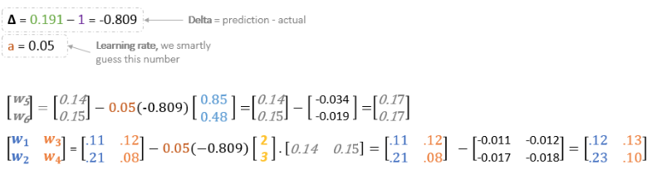

Numerical Example
$$γ$$
https://hmkcode.github.io/ai/backpropagation-step-by-step/

Slide 9
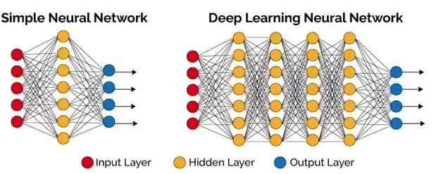
NN or DNN?
What is the difference between NN and DNN?
Different people have different definitions for DNN.
DNN is a regular ANN which has more than one hidden layer.
DNNs are more advanced NN models that are used for designing CNN, RNN,… models
An ANN is only good at learning the weights of a network with one hidden layer but does not contain multiple hidden layers and hence it cannot learn complex features. Deep learning can be expensive and require massive datasets to train itself on.

Slide 10
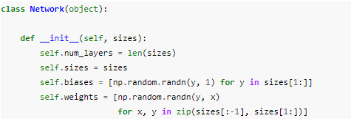
Back propagation example
We will work on the code which was provided on Canvas last week.
Let’s start with the provided class:
The bias and weights are randomly generated (mean=0, sd=1)
In this code, the list sizes contains the number of neurons in the respective layers. For example, if we want to create a Network object with 2 neurons in the first layer, 3 neurons in the second layer, and 1 neuron in the final layer, we'd do this with the code

Slide 11
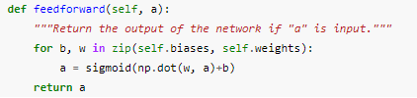
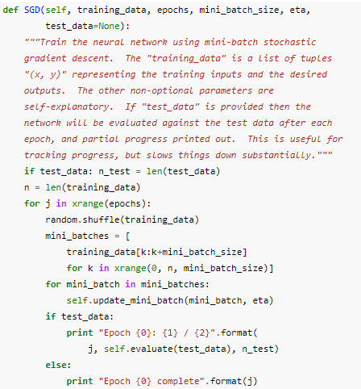
Back propagation example
You can see the parameters for example if you want to see the weights between hidden layer and output: net.weights[1]
Feedforward function, gets the input a and generates an output.
SGD- Stochastic Gradient Descent
training_data: a list of tuples (x, y) representing the training inputs and corresponding desired outputs
epochs: Number of iteration steps
mini-batches: size of batches
eta: learning rate

Slide 12
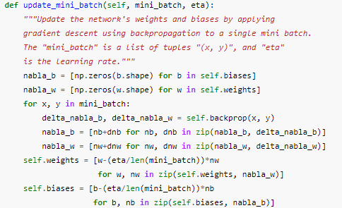
Back propagation example
In each epoch, it starts by randomly shuffling the training data, and then partitions it into mini-batches of the appropriate size.
self.update_mini_batch(mini_batch, eta): runs gradiet descent on each batch
The key part of the code is self.backprob(x,y) which returns weight and bias using backpropagation
Let’s leave the description of self.cost_derivative and self.backprop to later.

Slide 13
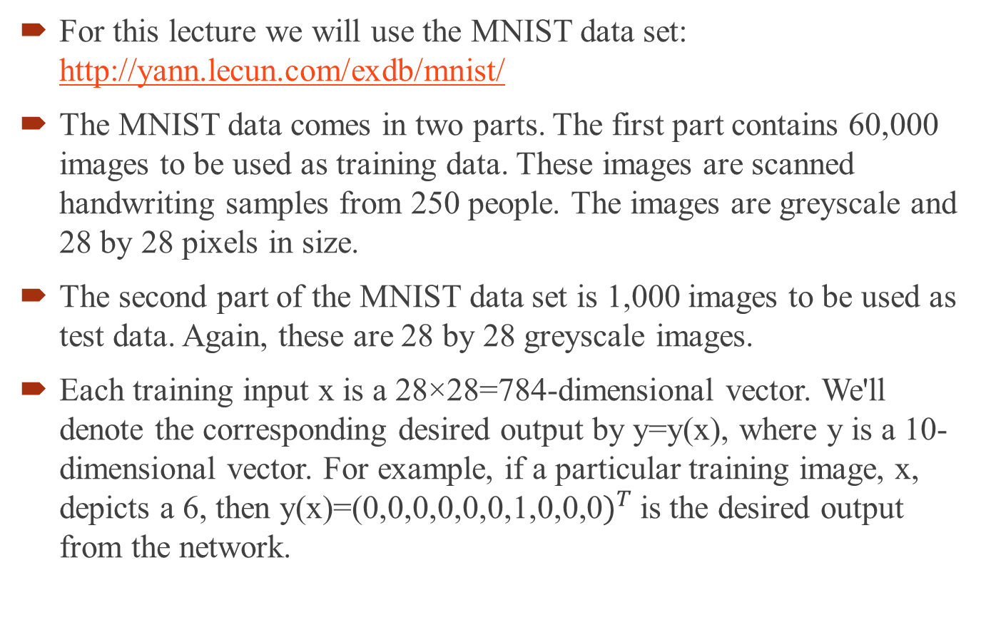
Back propagation example
For this lecture we will use the MNIST data set: http://yann.lecun.com/exdb/mnist/
The MNIST data comes in two parts. The first part contains 60,000 images to be used as training data. These images are scanned handwriting samples from 250 people. The images are greyscale and 28 by 28 pixels in size.
The second part of the MNIST data set is 1,000 images to be used as test data. Again, these are 28 by 28 greyscale images.
Each training input x is a 28×28=784-dimensional vector. We'll denote the corresponding desired output by y=y(x), where y is a 10-dimensional vector. For example, if a particular training image, x, depicts a 6, then y(x)=(0,0,0,0,0,0,1,0,0,0$)^{T}$ is the desired output from the network.

Slide 14

What is Keras?
Keras is an open source neural network library written in Python (later developed for R too). It is capable of running on top of TensorFlow, Microsoft Cognitive Toolkit, or Theano. Designed to enable fast experimentation with deep neural networks, it focuses on being user-friendly, modular, and extensible.

Slide 15
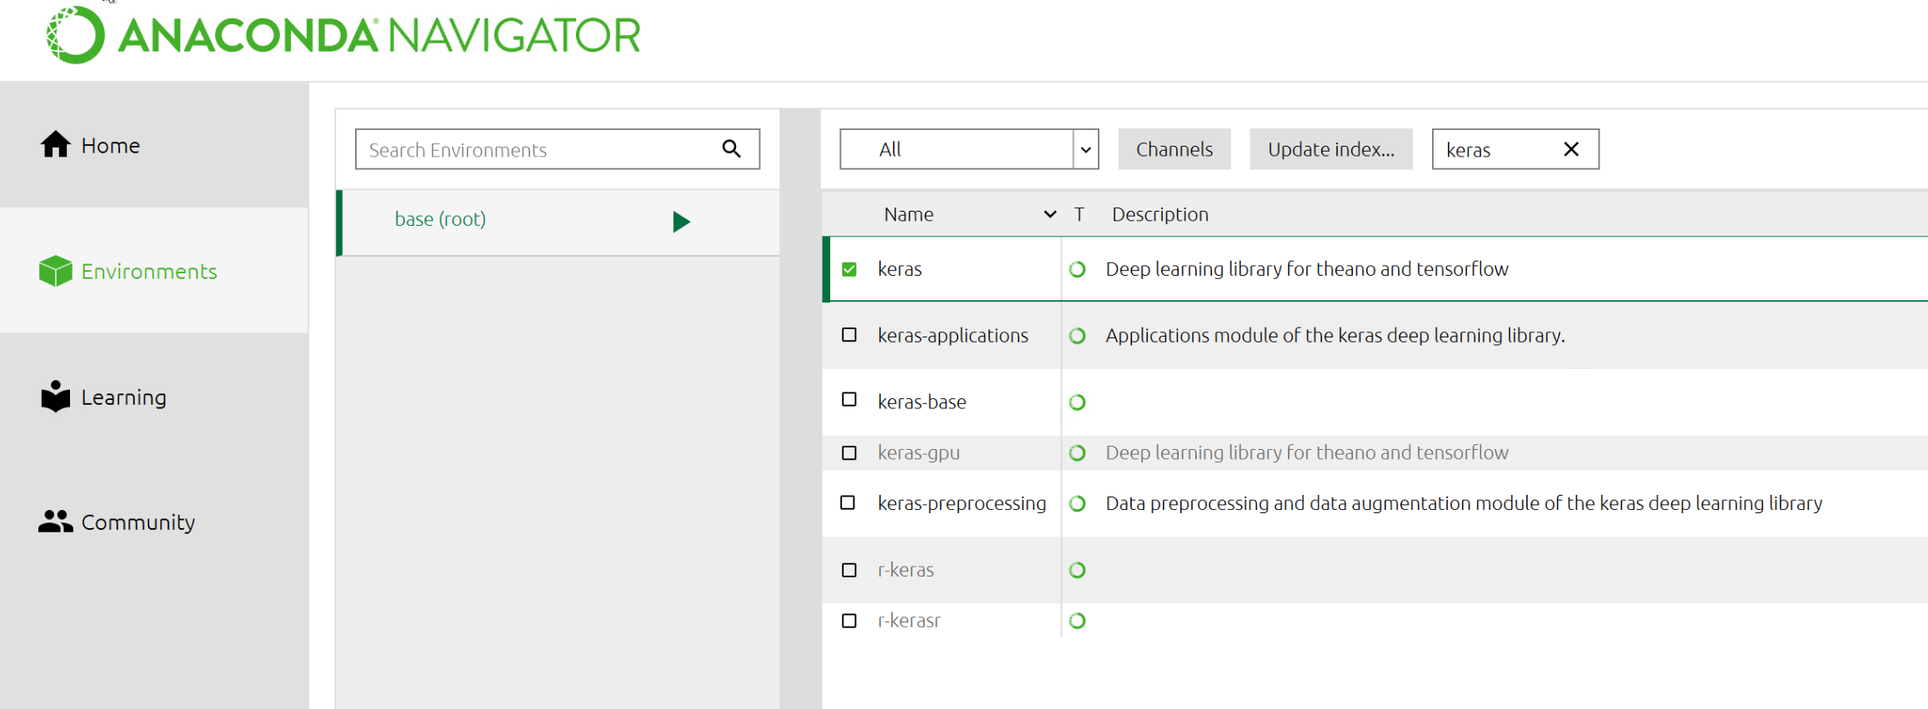
Keras installation
In Anaconda:
Go to Anaconda Navigator
OR: go to Anaconda prompt and type conda install keras
OR: Inside notebook type: !pip install keras
OR In Python
pip install keras

Slide 16
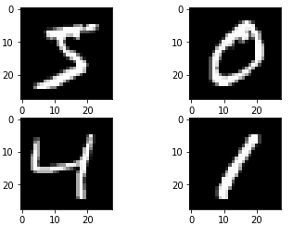
OCR in Keras
Let’s read the dataset from Keras
from tensorflow.keras.datasets import mnist
import matplotlib.pyplot as plt
# load (downloaded if needed) the MNIST dataset
(X_train, y_train), (X_test, y_test) = mnist.load_data()
# plot 4 images as gray scale
plt.subplot(221)
plt.imshow(X_train[0], cmap=plt.get_cmap('gray'))
plt.subplot(222)
plt.imshow(X_train[1], cmap=plt.get_cmap('gray'))
plt.subplot(223)
plt.imshow(X_train[2], cmap=plt.get_cmap('gray'))
plt.subplot(224)
plt.imshow(X_train[3], cmap=plt.get_cmap('gray'))
# show the plot
plt.show()

Slide 17
Data preparation
The training dataset is structured as a 3-dimensional array of instance, image width and image height. As we saw earlier let’s convert it to a vector of pixels. In this case the 28×28 sized images will be 784 pixel input values.
It is always a good idea to normalize the input data in NN
# flatten 28*28 images to a 784 vector for each image
num_pixels = X_train.shape[1] * X_train.shape[2]
X_train = X_train.reshape(X_train.shape[0], num_pixels)
X_test = X_test.reshape(X_test.shape[0], num_pixels)
# normalize inputs from 0-255 to 0-1
X_train = X_train / 255
X_test = X_test / 255

Slide 18
Data preparation
Next, we need to convert labels to categorical. Keras has the function np_utils.to_categorical
Now we are ready to build the model
Sequential starts to make the model. We can add layers by .add() function. And dense() will give the information about that layer.
Finally compile() will define the type of loss function, and output
Y_test = y_test
from keras.utils import np_utils
# one hot encode outputs
y_train = np_utils.to_categorical(y_train)
y_test = np_utils.to_categorical(y_test)
num_classes = y_test.shape[1] #10 classes

Slide 19
Design Model
Here is a sample model
Now we can call this function and train our own data
epoch will tell us number of iterations
from tensorflow.keras.models import Sequential
from tensorflow.keras.layers import Dense
#from tensorflow.keras import optimizers
hidden_layer_nodes=50
def baseline_model():
# create model
model = Sequential()
model.add(Dense(hidden_layer_nodes, input_dim=num_pixels, activation='sigmoid'))
model.add(Dense(hidden_layer_nodes, activation='sigmoid'))
model.add(Dense(num_classes, activation='sigmoid'))
#sgd = optimizers.SGD(lr=0.01, momentum=0.0, decay=0.0)
# Compile model
#model.compile(loss='mean_squared_error', optimizer='adam', metrics=['accuracy'])
model.compile(loss='mean_squared_error', optimizer=‘sgd', metrics=['accuracy'])
return model

Slide 20
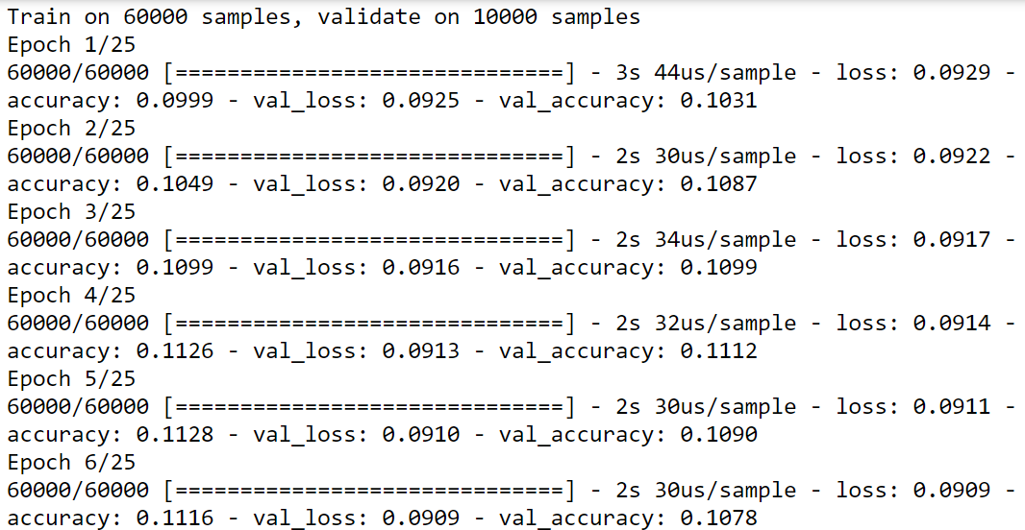
Evaluate Model
Call the model
model = baseline_model()
# Fit the model
nn_simple = model.fit(X_train, y_train, validation_data=(X_test, y_test), epochs=25, batch_size=200)
# Final evaluation of the model
scores = model.evaluate(X_test, y_test, verbose=2)
print("Baseline Error: %.2f%%" % (100-scores[1]*100))
print("Accuracy: %.2f%%" % (scores[1]*100))

Slide 21
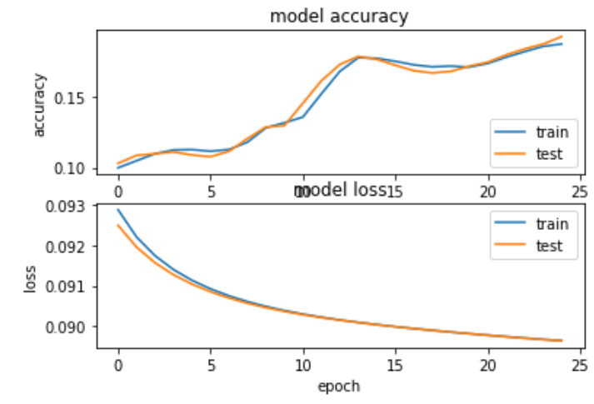
Evaluate Model
Accuracy graphs
plt.subplot(2,1,1)
plt.plot(nn_simple.history['accuracy'])
plt.plot(nn_simple.history['val_accuracy'])
plt.title('model accuracy')
plt.ylabel('accuracy')
plt.xlabel('epoch')
plt.legend(['train', 'test'], loc='lower right')
plt.subplot(2,1,2)
plt.plot(nn_simple.history['loss'])
plt.plot(nn_simple.history['val_loss'])
plt.title('model loss')
plt.ylabel('loss')
plt.xlabel('epoch')
plt.legend(['train', 'test'], loc='upper right')
plt.show()

Slide 22
Model performance
We can see the performance of model graphically.
predicted_classes = model.predict_classes(X_test)
# see which we predicted correctly and which not
correct_indices = np.nonzero(predicted_classes == Y_test)[0]
incorrect_indices = np.nonzero(predicted_classes != Y_test)[0]
print()
print(len(correct_indices),"classified correctly")
print(len(incorrect_indices),"classified incorrectly")
# adapt figure size to accomodate 18 subplots
plt.rcParams['figure.figsize'] = (7,14)
figure_evaluation = plt.figure()
# plot 9 correct predictions
for i, correct in enumerate(correct_indices[:9]):
plt.subplot(6,3,i+1)
plt.imshow(X_test[correct].reshape(28,28), cmap='gray', interpolation='none')
plt.title(
"Predicted: {}, Truth: {}".format(predicted_classes[correct],
Y_test[correct]))
plt.xticks([])
plt.yticks([])

Slide 23
Model performance
We can see the performance of model graphically.
# plot 9 incorrect predictions
for i, incorrect in enumerate(incorrect_indices[:9]):
plt.subplot(6,3,i+10)
plt.imshow(X_test[incorrect].reshape(28,28), cmap='gray', interpolation='none')
plt.title(
"Predicted {}, Truth: {}".format(predicted_classes[incorrect],
Y_test[incorrect]))
plt.xticks([])
plt.yticks([])
figure_evaluation

Slide 24
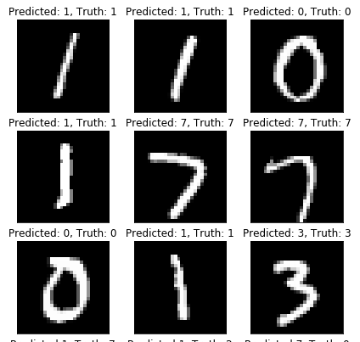
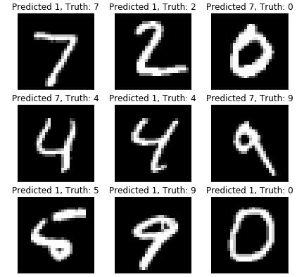
Model performance
Some of results:

Slide 25
Assignment 3
1- Change the number of neurons in hidden layers to 75. See the accuracy and compared it to the baseline.
2- Change the number of epochs to 35 and see if it has any effect (50 neurons)
3- Add one more layer to the designed neural network and see the result (This layer contains 25 nodes). Draw graphs and compare accuracies.
These are 3 independent questions. So you need to have three sections in your solution that answers to any of these questions
Please run your code in python notebook and submit an html file that contains both code and result. You can use any other python IDE but the result should contain the code and the output of it (please do not copy/pate results)
PLEASE DO NOT SUBMIT JUST THE PURE CODE (.py or .txt or ipynb or…)- IT WILL NOT BE GRADED.

